Slide 1


Annex B
My Community of Practice (COP) Journal

Slide 2
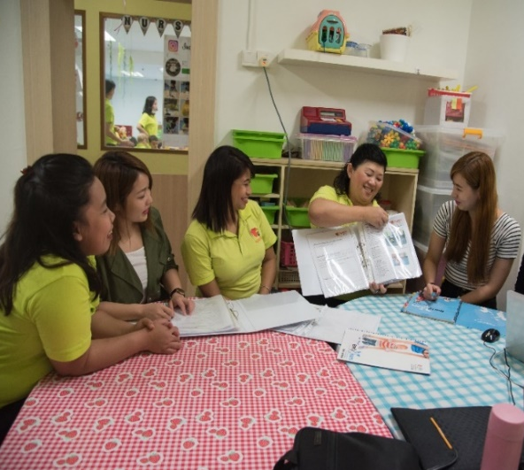
Annex B
My Community of Practice (COP) Journal
What is CoP?
I meet up with other educators from my/other centres to share and learn best practices from one another
What did we learn?
Collect our learning experiences through
photos with captions,
short video clips OR
reflections
Why CoP?
I can
learn from other educators
exchange ideas and experiences to improve my teaching-learning practices
What do we do?
Read up or think about the topic of interest before meeting
Share my lesson plans and teaching practices
Listen and learn from others
Improve my lesson plans and try them out
Share my learning at the next CoP
How to start?
I can form a group with participants in the PDP (E) Compulsory Training
OR
with my colleagues in my centre and/or other centres
Where to meet?
Find a place that is convenient and conducive for discussions e.g. pre-school centres, libraries or community centres.
How often do we meet?
Meet regularly for about 6 to 10 times in a year, e.g., 1-2 hours per session, once a month
To help us keep track of your PDP hours, please ensure that your group sends the following to ecda_pp@ecda.gov.sg at the end of your last COP session. Only 1 submission per group is required.
1 copy of Annex B1
1 copy of Annex B2 for each CoP session
1 copy of Annex B3
Participants may submit soft copies to ECDA_PP@ecda.gov.sg or in hard copy to:
51 Cuppage Road
#08-01 S(229469)
Attn: PDP(E) Secretariat

Slide 3
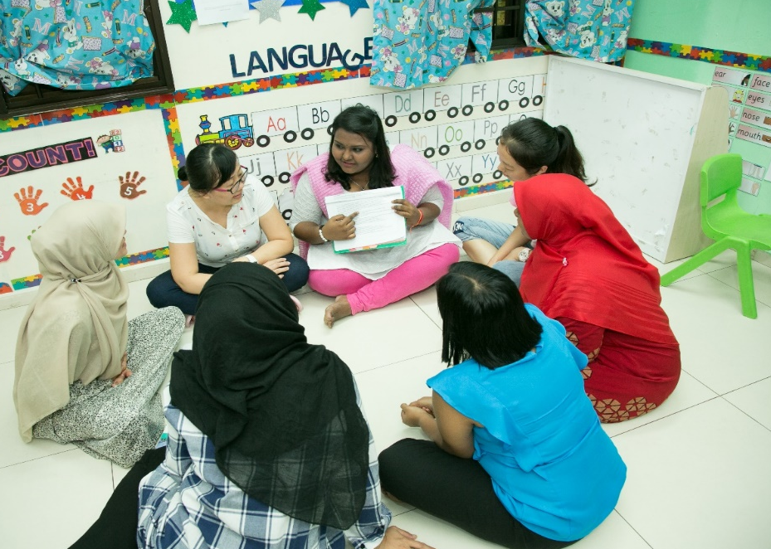

Annex B1
Details of CoP Group Members
s/n | Name of Member | Name of Centre | PDP (E) Participant (Yes/No)
1
2
3
4
5
6
7
8
Total no. of sessions: _____________
Total no. of hours: _____________
Verified by
Name of Centre Leader/Supervisor: ________________________
Signature of Centre Leader & Date: ________________________
To submit 1 copy of Annex B1
per group

Slide 4
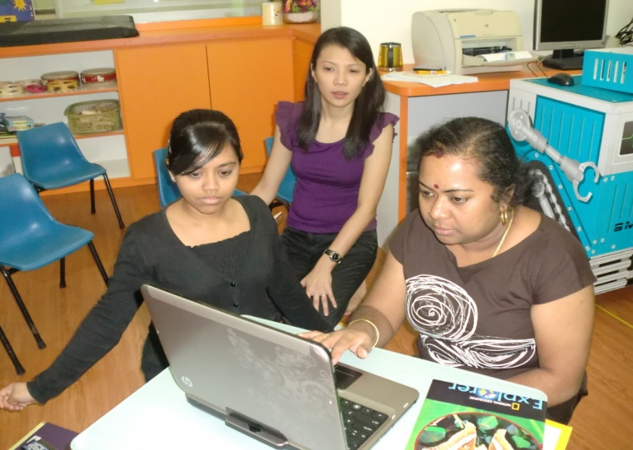
Annex B2
Details of our COP session
Session No:
Date / Time: | Duration:
What we plan to discuss at the session…
*To submit 1 copy of Annex B2 for each COP session

Slide 5

Annex B3
What did we learn ?
Collect our learning experiences through any of the following:
      photos with captions
      short video clips
      reflections
Photo Album: Our Learning Journal- A collection of photos with captions
You can photograph how your group has implemented and carried out the ideas and discussions exchanged during the CoP, in your classroom!
(Captions for the photo) ____________________________________________________________________________________
< Insert photo >
<Insert Photo here>
(Captions for the photo) ____________________________________________________________________________________
< Insert photo >
<Insert Photo here>
< Insert photo >
<Insert Photo here>
(Captions for the photo) ____________________________________________________________________________________

Slide 6


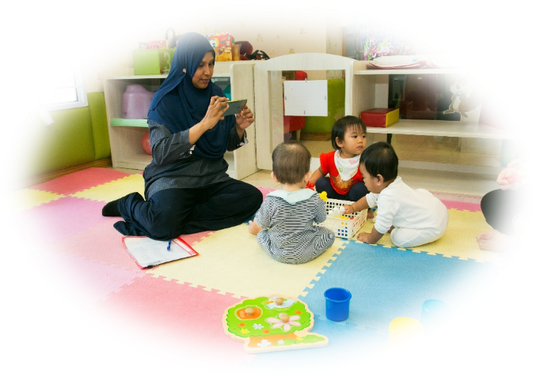
b) Reflection Journal:
Together with your group, you may reflect on learning points, and think of ideas for improvement.
REFLECTION JOURNAL
Learning Points:
Ideas for improvement:
c) Video album: Our learning experiences- A collection of short video clips (not more than 30 seconds each)
*To submit 1 copy of Annex B3 per group

Slide 7
[Reminder] Guidelines on the Use of Social Media Platforms
Participants are encouraged to agree on ways of communication that allow for meaningful exchange of information on learning and experiences.
To protect and safeguard the rights of your centre/organization, teachers, children and their families, the following guidelines* are proposed when communicating through social media platforms:
• Exercise good judgment. Be accountable for actions and statements that could have a negative impact on others. Information posted online may become public information. Do not upload statements, photographs, videos or audio files that could be viewed as malicious, undesirable, threatening or intimidating to others.
• Be respectful. Always be fair, tactful, polite and respect others
• Respect intellectual property rights. Adhere to the copyright, trademark and intellectual property rights regulations. Do not post information or attachments that will infringe the intellectual property rights of others.
• Seek consent before using logos or trademarks that belong to organizations and/or uploading images or videos. Only use them when permission has been given. For example, do not use the ECDA logo without permission.
• Refrain from sharing and uploading images of children, parents and centre personnel. Always seek written consent from parents and colleagues before uploading children’s images or videos online.
• Be actively engaged. Contribute, learn and add value to the discussions.
*Adapted from: Media Literacy Council, The 10 Cyberspace Commandments: http://www.medialiteracycouncil.sg/Resources/Pages/General.aspx

